Slide 1
Lvl 4/5 Group 14 IMDCGD111-16YRD
Alex Polley, Henry Crofts and Michael Curtis

Slide 2
Demographic
Male Teenagers 13- 18
Already have an interest in competition which often increases with age
Teens both male and female are interested in new experiences that can happen through gameplay
(Schell 101,103)

Slide 3
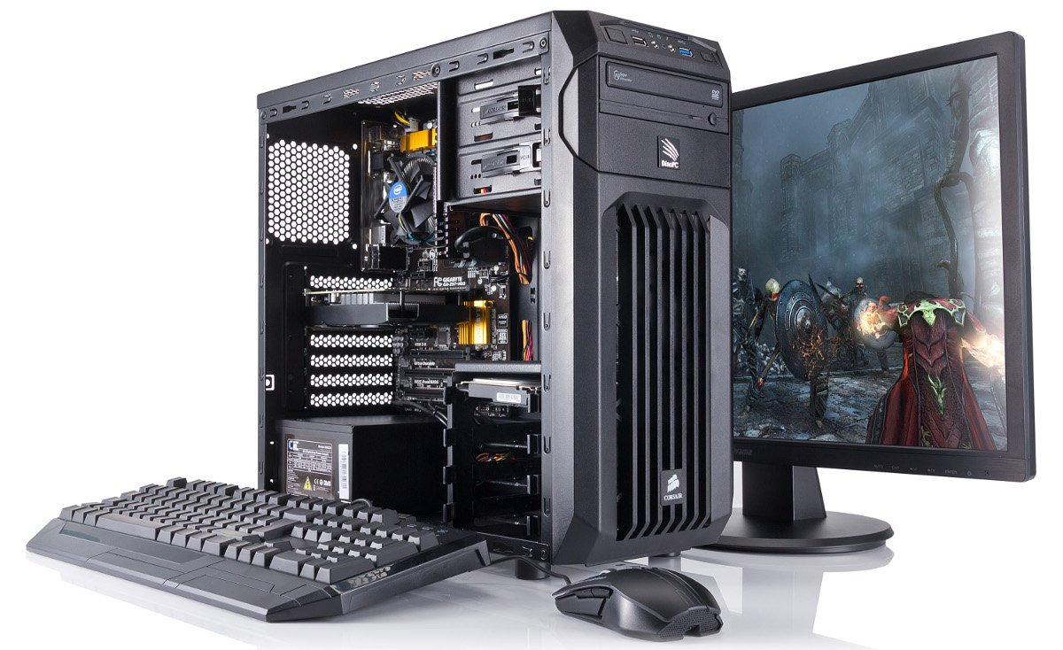
Platform

Slide 4
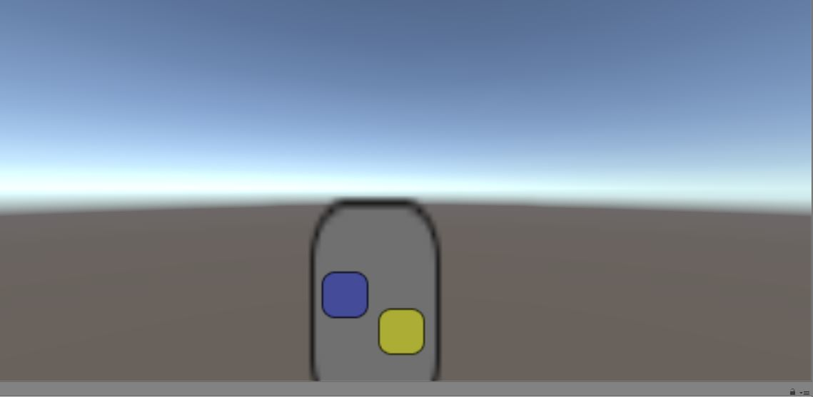
Concepts from Last Presentation
Friction Game
Twitch mechanic
Players must move their piece across a pathway with varying resistances
The resistance is overcome by rapid tapping on the screen
First player to reach the end is the winner

Slide 5
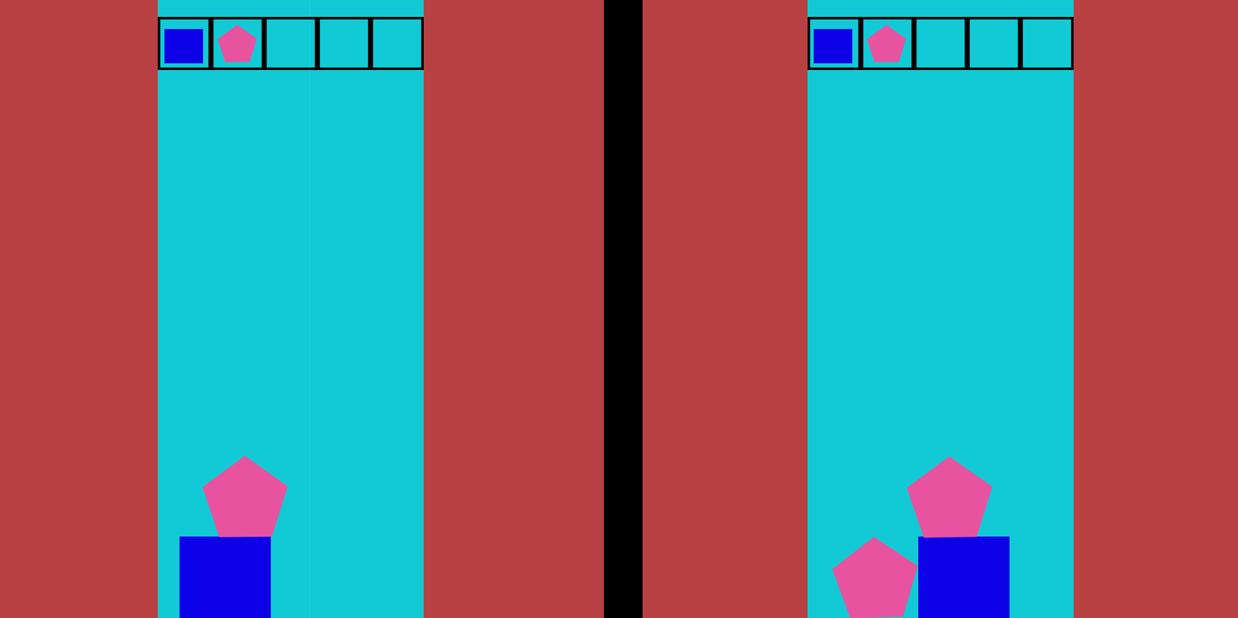
Concepts from Last Presentation
Gravity Game
Our gravity based game is a tower building game
Players must try and balance shapes they are given
If one player chooses a shape the other player must also use that shape

Slide 6
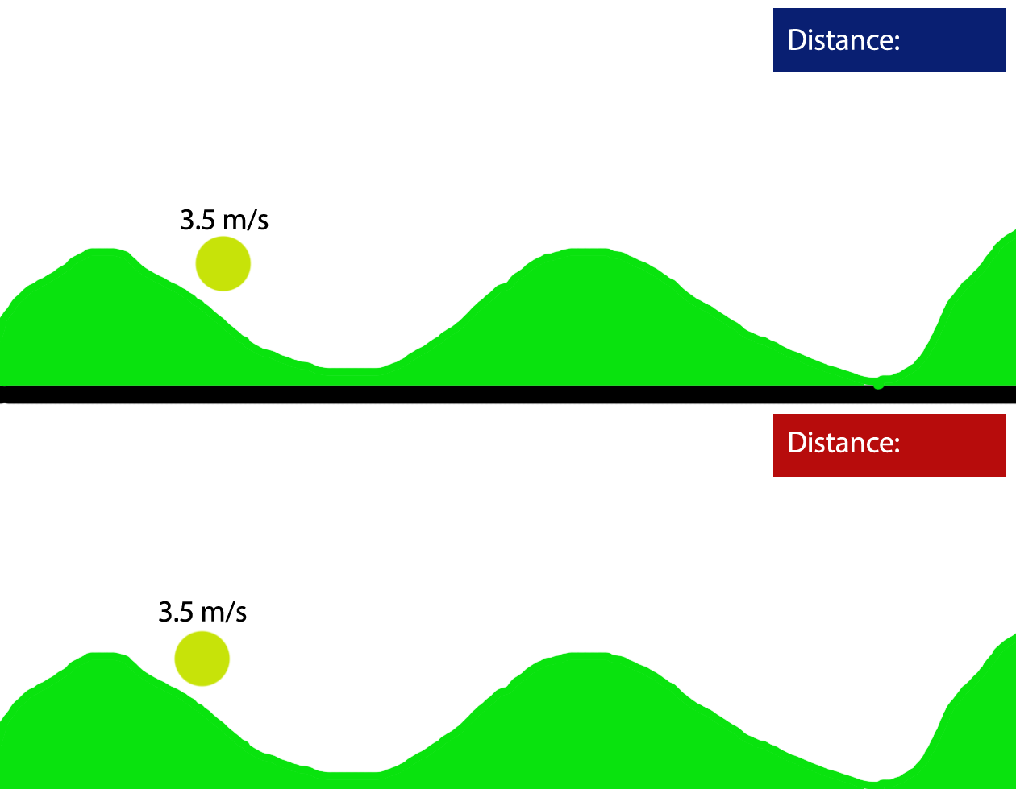
New Concept

Slide 7
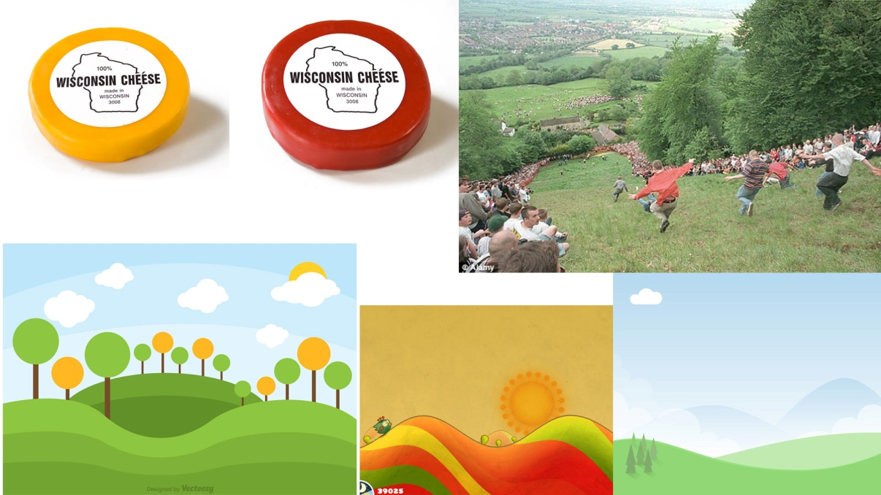



Art Style

Slide 8
Background
Here show some background art and some sound clips
Talk about the theme – BRITISH SUMMER TIME

Slide 9
Gameplay
Video

Slide 10
Playtesting
Talk about play test feedback

Slide 11
Going Forward

Slide 12
Management
Display JIRA hours here
Talk about communication

Slide 13
Questions?

